Slide 1

Big Data
Presented By:
Elizer Ponio Jr. Department of Computer Science
College of Computing and Information Technologies

Slide 2
Outline
Business Intelligence and Data Analytics
Data Warehouses
Multidimensional Analysis and Online Analytical Processing (OLAP)

Slide 3
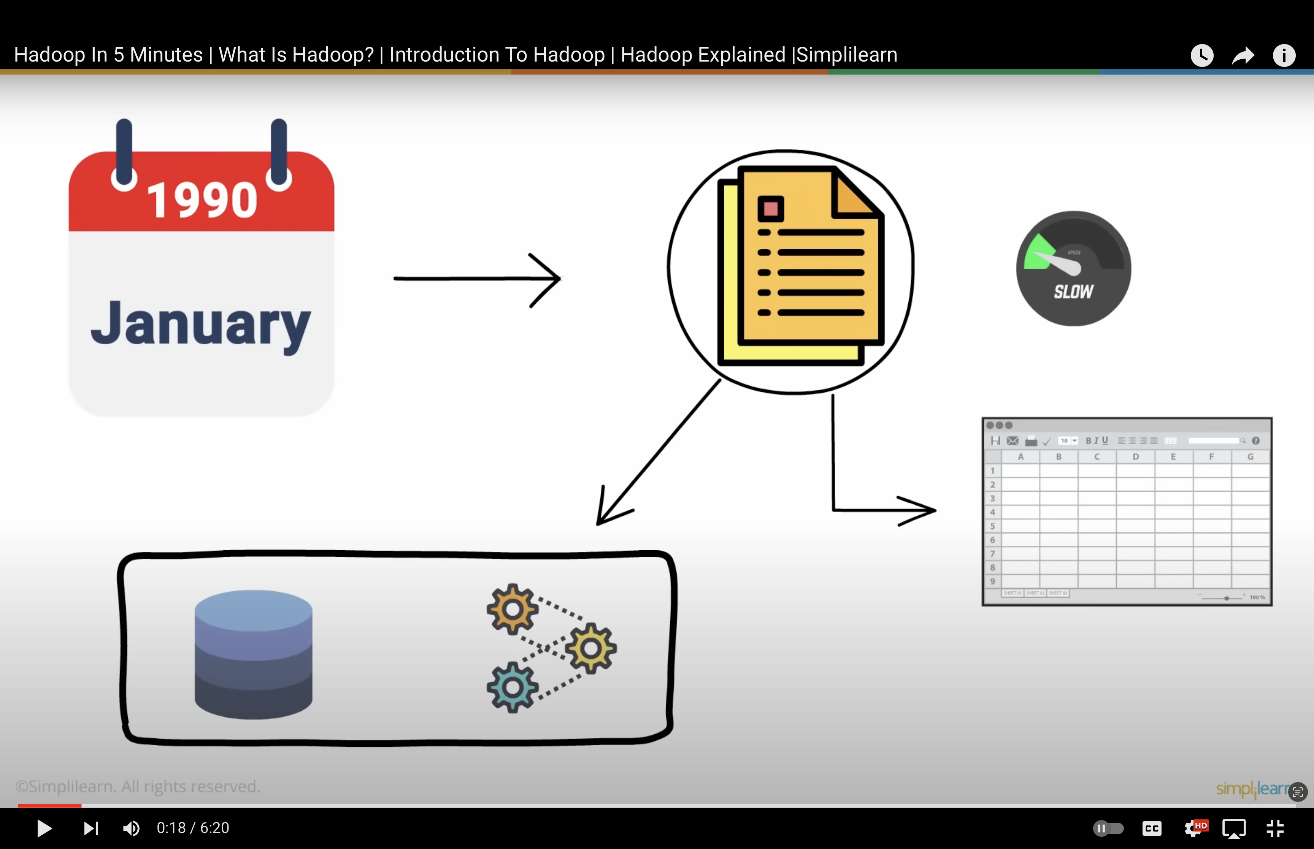

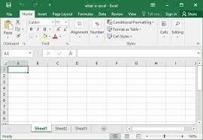





Slide 4

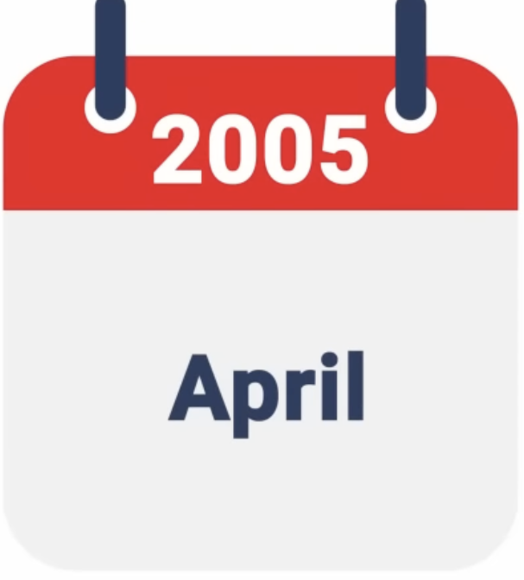





Slide 5





Big Data

Slide 6





Slide 7


Hadoop

Slide 8
Components of Hadoop
Hadoop consisted of three components that were specifically designed to work on big data.
Storage Unit
Map Reduce
3

Slide 9
Hadoop - Storage Unit
The first component of Hadoop is its Storage Unit, called the Hadoop Distributed File System or (HDFS).

Slide 10

Hadoop - Storage Unit
Data is stored in many computers and is stored in blocks

Slide 11

Hadoop - Storage Unit
600 mb
Block A
Block B
Block C
Block D
Block E
128 mb
128 mb
128 mb
128 mb
88 mb

Slide 12
Hadoop - Storage Unit
600 mb
Block A
Block B
Block C
Block D
Block E
128 mb
128 mb
128 mb
128 mb
88 mb
Replication Method
Data is not lost at any cost even if one DataNode crashes, making HDFS fault tolerant
Block A
Block A
HDFS makes copies of the data and stores it across multiple systems

Slide 13
Map Reduce

Slide 14





Hadoop – Map Reduce
Traditional processing method
Final output
Processing large volumes of a variety of data

Slide 15
Input
Split
Mapper Phase
Shuffle and Sort
Reduce Phase
one
One a penny
one, 1
a, 1
penny, 1
a
a
a, 2
buns, 1
cross, 1
hot, 1
one, 1
penny, 2
two, 1
One a penny, two a penny, hot cross buns
penny
penny
two a penny
two, 1
a, 1
penny, 1
two
hot
hot cross buns
hot, 1
cross, 1
buns, 1
cross
buns

Slide 16



Hadoop – Map Reduce
Input
Split
Mapper Phase
Shuffle and Sort
Reduce Phase
one
One a penny
one, 1
a, 1
penny, 1
a
a
a, 2
buns, 1
cross, 1
hot, 1
one, 1
penny, 2
two, 1
One a penny, two a penny, hot cross buns
penny
penny
two a penny
two, 1
a, 1
penny, 1
two
hot
hot cross buns
hot, 1
cross, 1
buns, 1
cross
buns

Slide 17



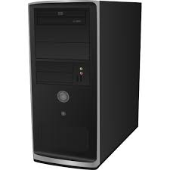

YARN

Slide 18





YARN
Resource Manager
Container
Node Manager
Application Master

Slide 19
YARN
Resource Manager
Node Manager
Application Master

